Slide 1
manual

Slide 2
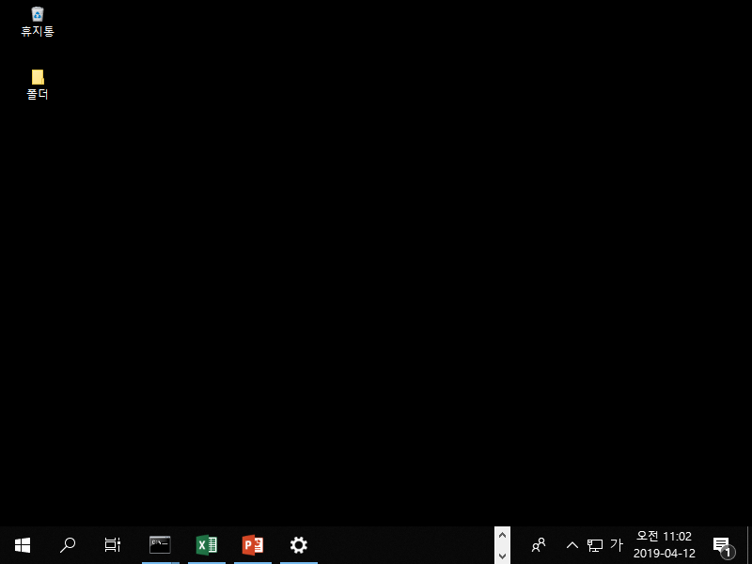
1. Folder access (Auto 1~2)

Slide 3

1. Folder access (Auto 1~2)

Slide 4
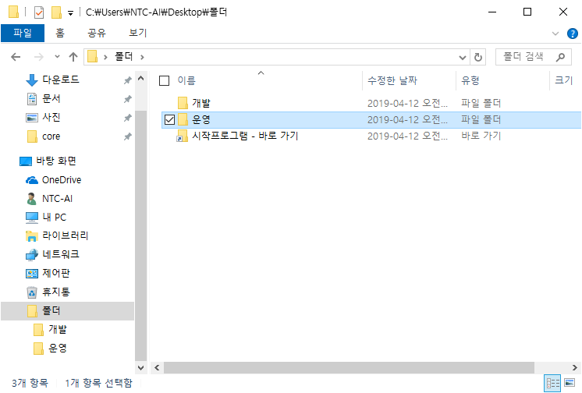
1. Folder access (Auto 1~2)

Slide 5
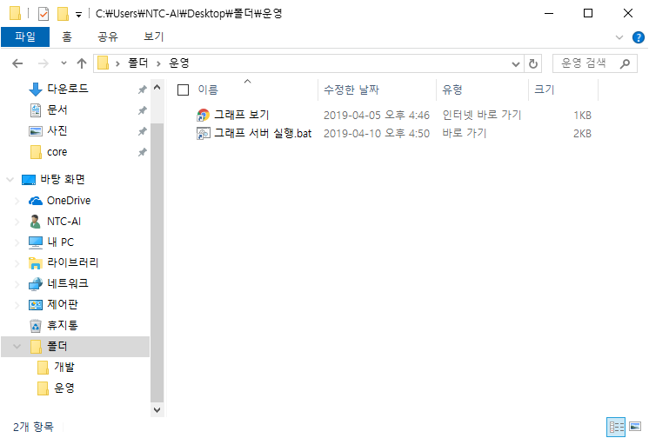
1. Folder access (Auto 1~2)

Slide 6
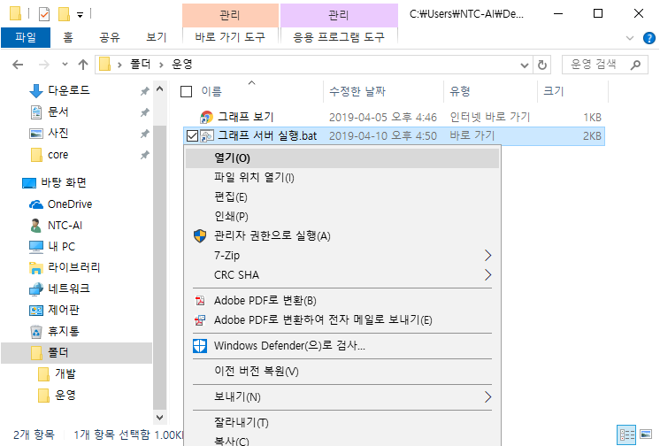
2. Start server (Auto 1~2)

Slide 7
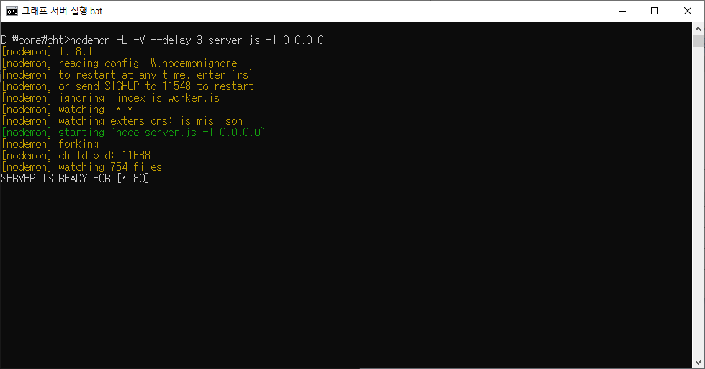
2. Start server (Auto 1~2)
Notes:
cmd : nodemon –L –V –delay 3 D:\core\cht\server.js –l 0.0.0.0

Slide 8
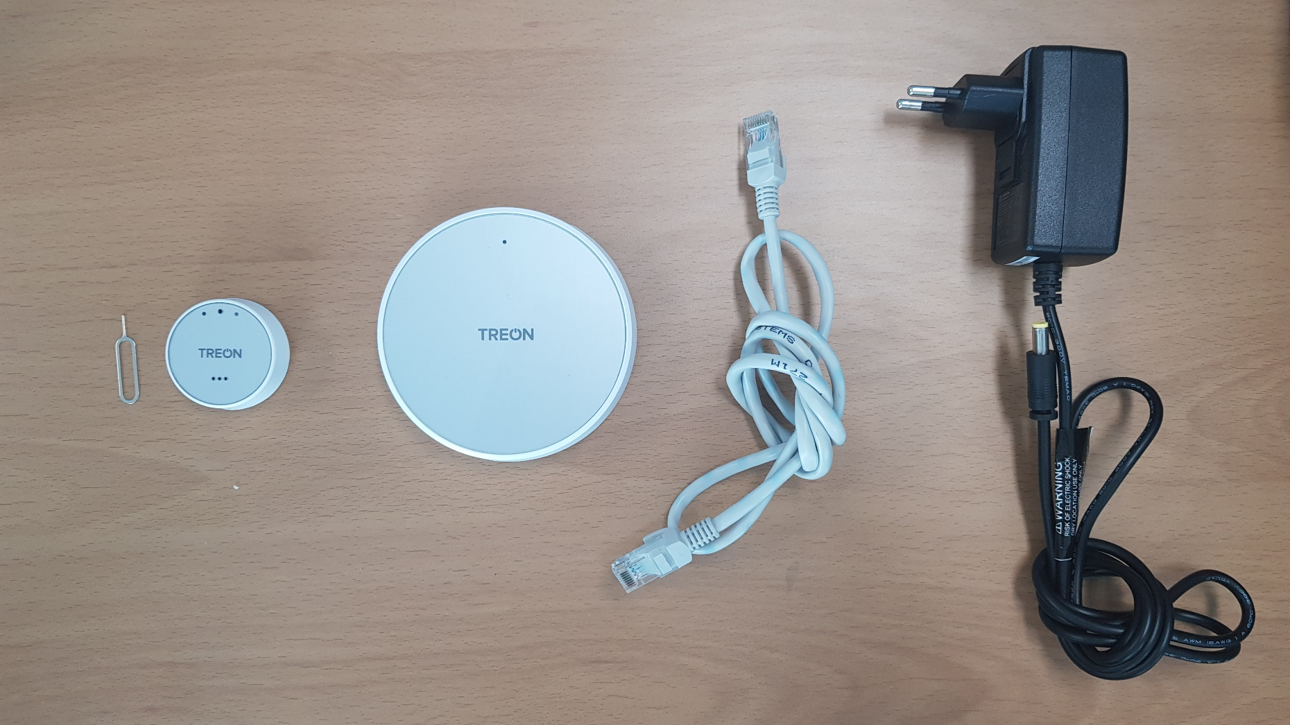
3. Start gateway
Notes:
(1) sensor node clip, (2) sensor node, (3) gateway, (4) LAN cable, (5) power adapter for gateway

Slide 9
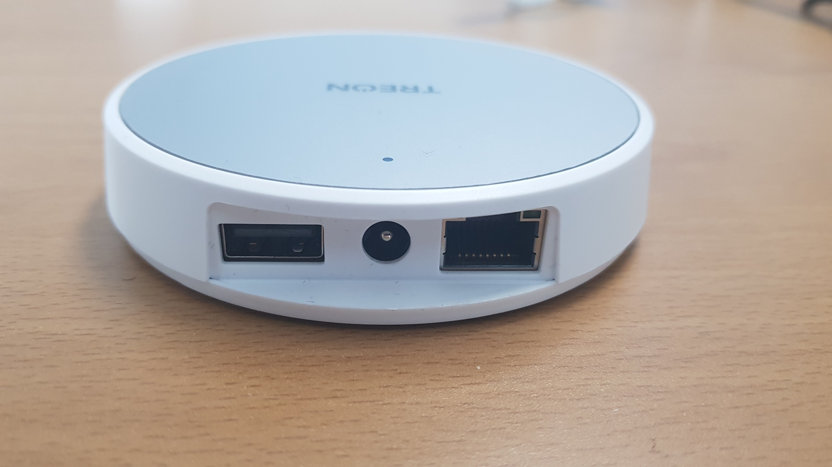
3. Start gateway
Notes:
ports are beside back of gateway

Slide 10
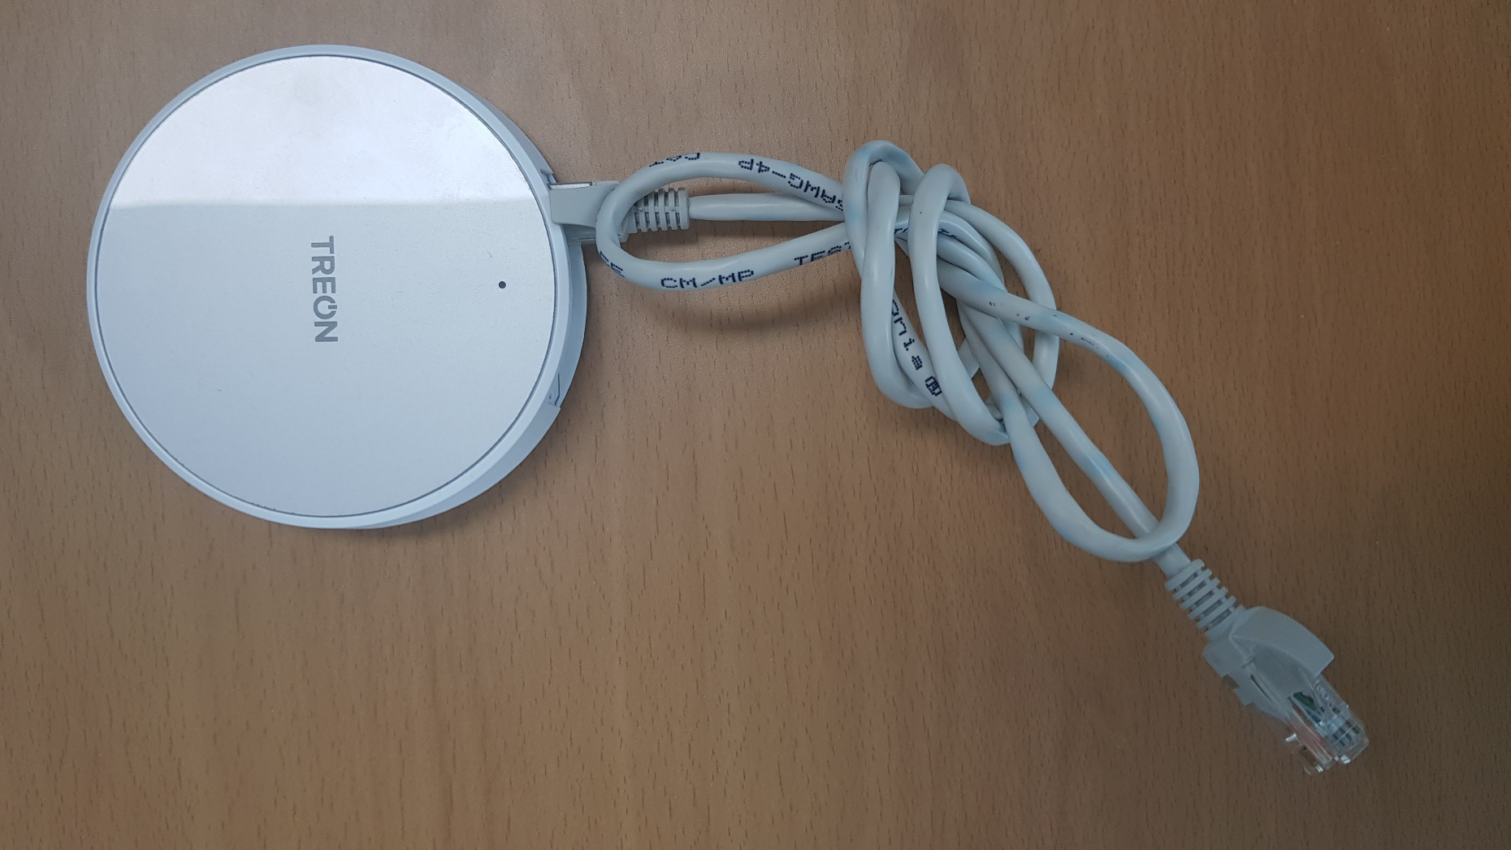
3. Start gateway
Notes:
put (4) LAN cable into the (3) gateway

Slide 11
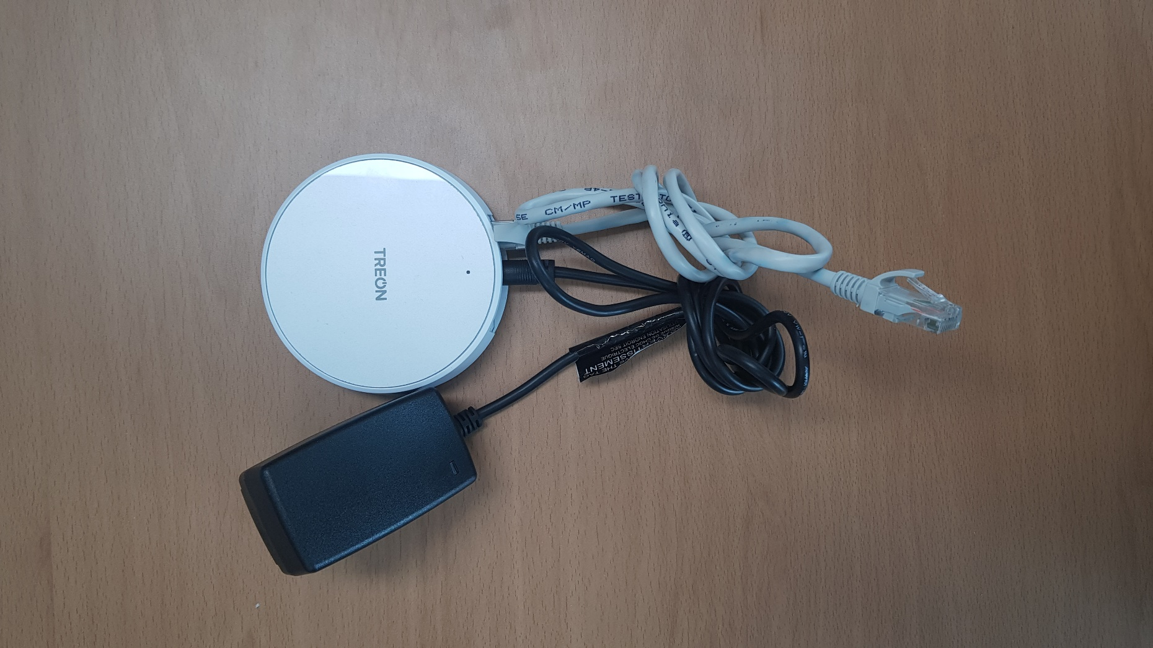
3. Start gateway
Notes:
put (5) power adaptor into the (3) gateway

Slide 12
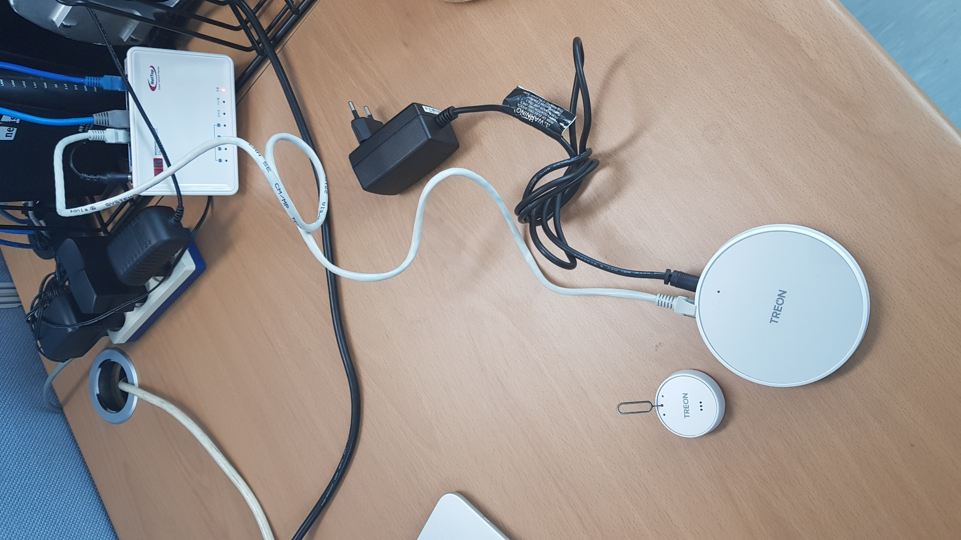
3. Start gateway
Notes:
put LAN cable into router

Slide 13
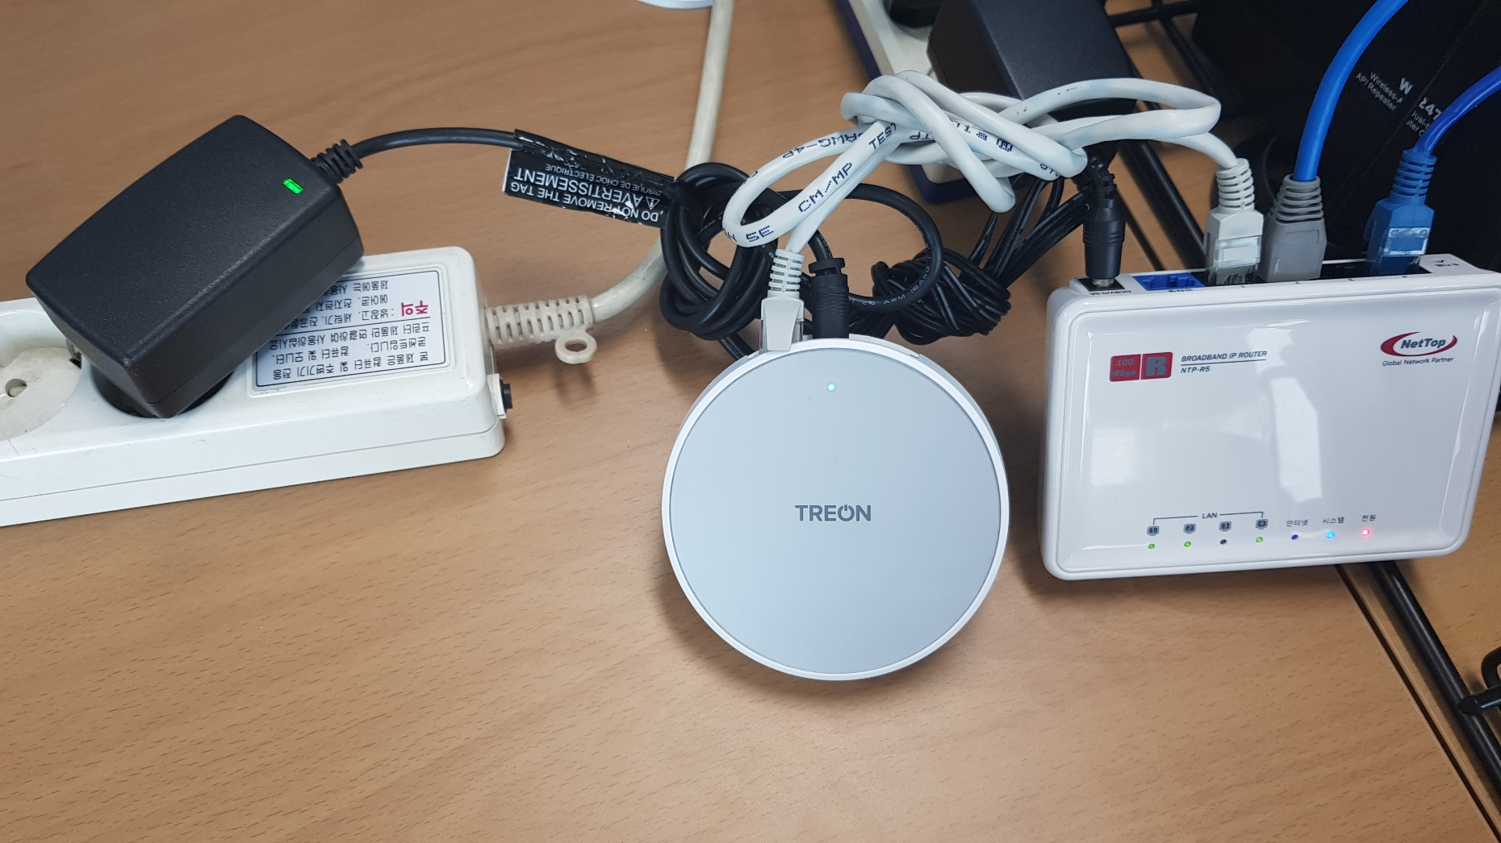
3. Start gateway
Notes:
put adaptor into consent. LED light will cyan at first

Slide 14
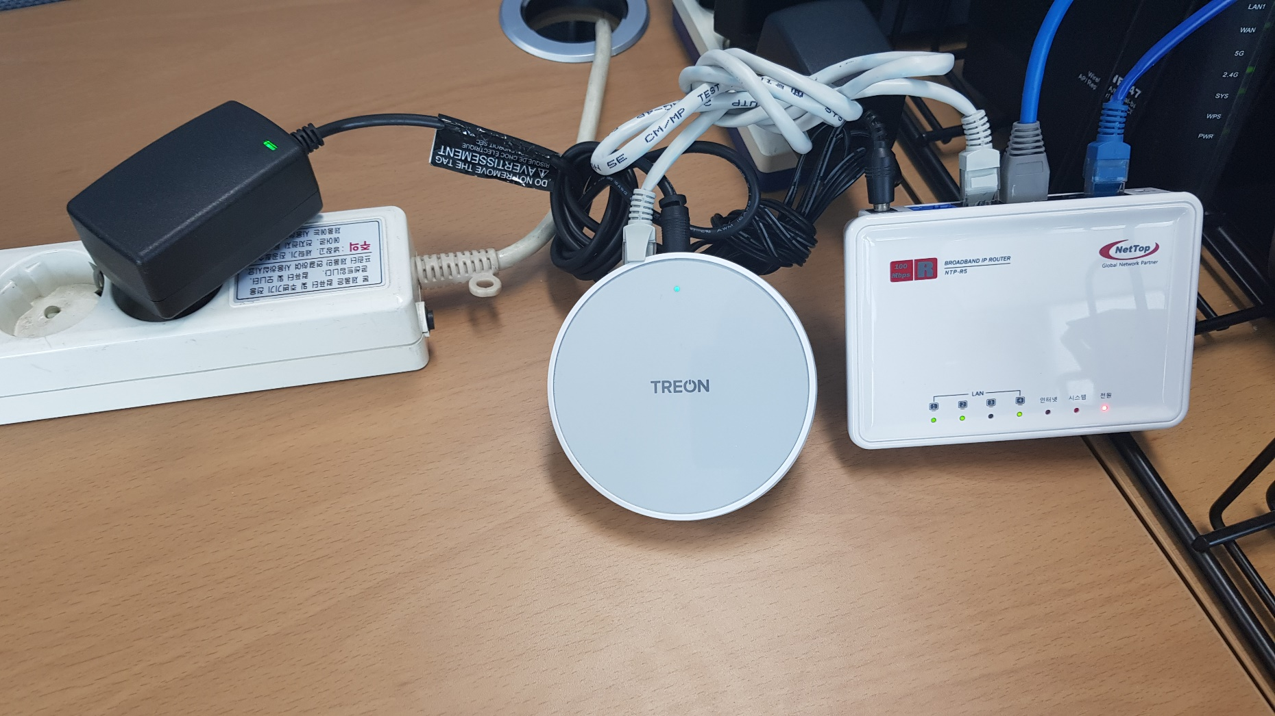
3. Start gateway
Notes:
wait until LED light become green. gateway data sender will be run by system automatically.
If LED light become red, check or re-establish the network and connection status.

Slide 15

3. Start gateway
Notes:
put (1) sensor node clip into (2) sensor node’s center hole until LED light become green. this is a power switch of sensor node

Slide 16
4. Start client
Notes:
then all of hardware is ready. run the graph server.

Slide 17
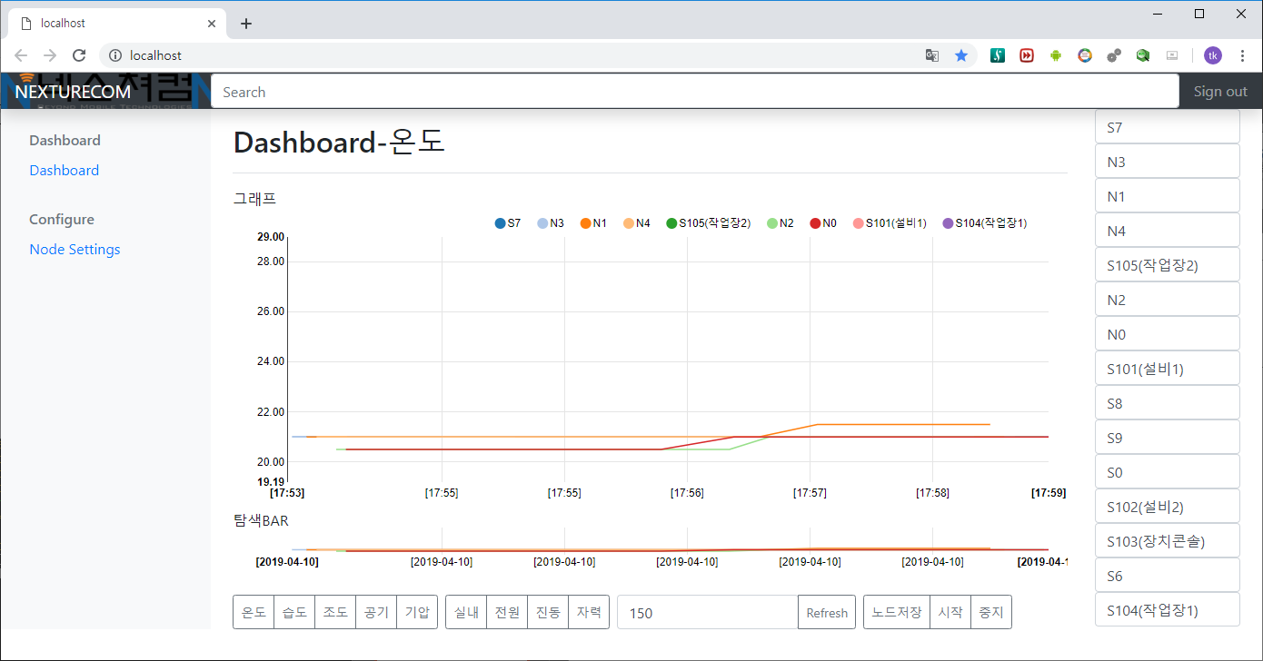
4. Start client
Notes:
The buttons were all named by a friendly description for manage the dashboard.
sensor node name can be changed by any client and sharing for each other.

Slide 18
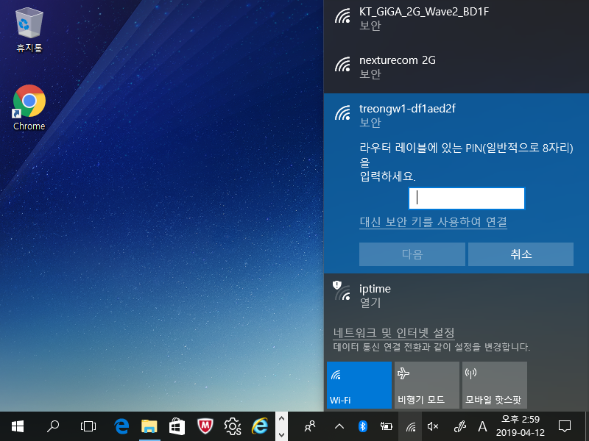
5. Emergency : direct access to gateway
2
3
1
Notes:
Press wi-fi icon at right side of taskbar (if not show, search the “windows 10 wi-fi connection” at internet. and find the treongw1-******* (specific 8 characters as serial of product) and click this.
if ask PIN number, do not write at PIN and press the “use secure key (for connect)”.

Slide 19
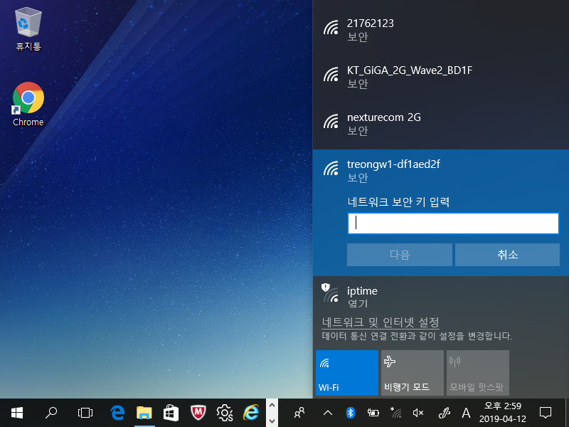
5. Emergency : direct access to gateway
Notes:
Password is 7670f69f

Slide 20
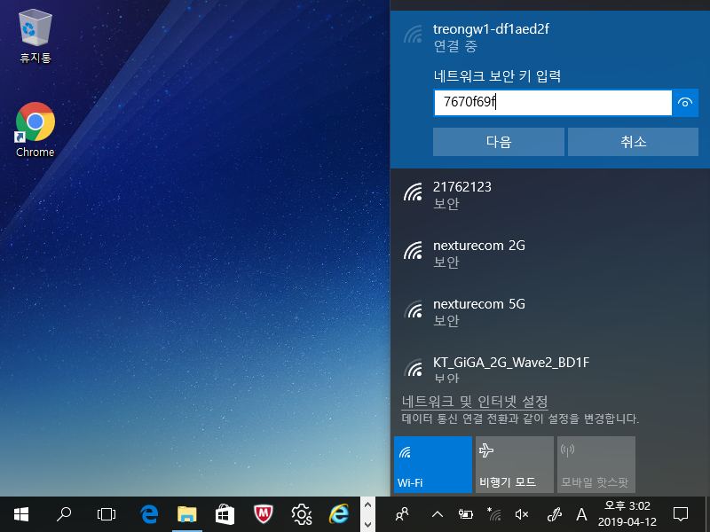
5. Emergency : direct access to gateway
Notes:
Password is 7670f69f
Press next button to connect

Slide 21
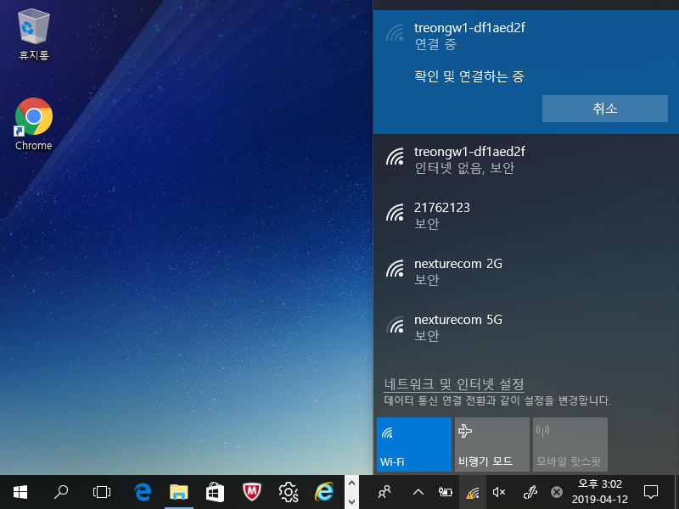
5. Emergency : direct access to gateway

Slide 22
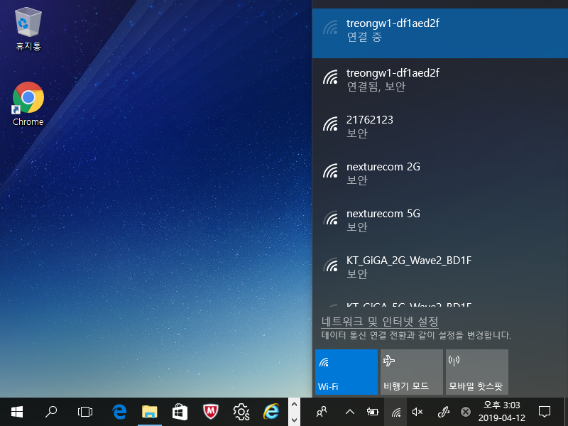
5. Emergency : direct access to gateway
Notes:
Then, ready to connect directly to treon gateway with wireless connection.

Slide 23
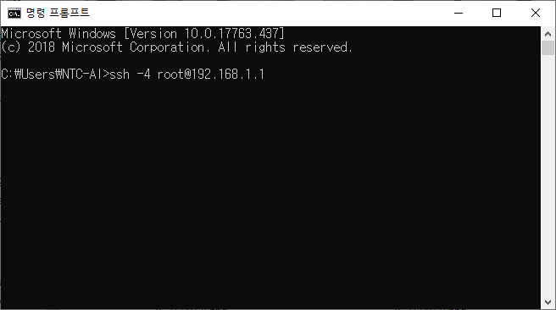
5. Emergency : direct access to gateway
Notes:
when connect with wireless connection directly with treon gateway, run ssh with ‘192.168.1.1’ or ‘192.168.*.*’. * can be 0~2 or others(0~255).
then, check ip address of gateway at router with ifconfig and note it.

Slide 24
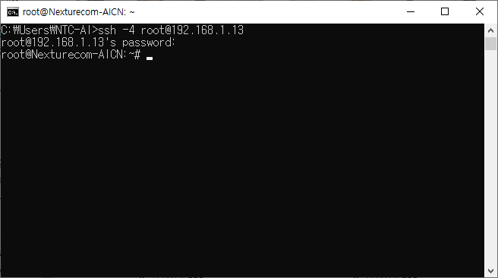
5. Emergency : direct access to gateway
Notes:
use checked ip address at ifconfig for ssh. Id is root and password is q34tq34t.
bash shell command : python /opt/iotgw/ntclog.py

Slide 25
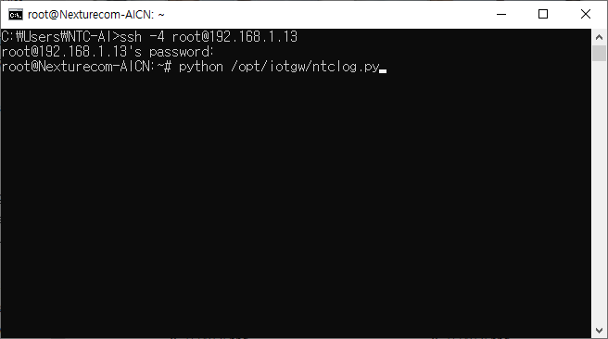
5. Emergency : direct access to gateway
Notes:
bash shell command : python /opt/iotgw/ntclog.py
Then sensor node data will be show at display immediately.

Slide 26
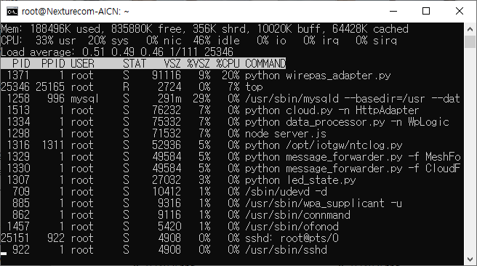
5. Emergency : direct access to gateway
Use only when the network is operating normally and the operation of the gateway suspected.
Kill current process “python /opt/iotgw/ntclog.py” before new process running.
Notes:
Use only when the network is operating normally and the operation of the gateway suspected.
Kill current process “python /opt/iotgw/ntclog.py” before new process running.
After run sender, watch the client showing a sensor node data.

